Slide 1
The “Haut marais de Coeur” (Auvergne, France): preservation of the biodiversity of a salted marsh by a private/association partnership
Franck Chignier-Riboulon, Territoires, Clermont-Auvergne University
Cairns, Conference, june 25th 2024

Slide 2
introduction
A late discovery
A partnership
A mutual interest
From discovery to firm strategy
A long term process

Slide 3
Location of “massif central” and “limagne” plain
Location in the centre of France
500 kms South of Paris
“Massif central”, an expression invented in the mid-19th
Limagne is a plain inside the massif
Located North of Clermont-Ferrand, the main regional city

Slide 4
The ‘limagne plain’, a collapse basin
Limagne, a collapse basin
Three “plains” in one
The wet Limagne, a current wealthy area for grains
Historically a repulsive land, with marshes
Sanitary risks
drainage
Cleaning up works
Extending farmland

Slide 5
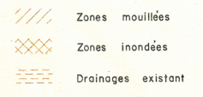
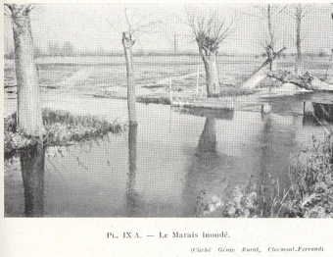
A long history of human conquest
Since Ancient period (Ballut, 2006, Trément, 2011)
Still wetlands in the mid-20th (Derruau, 1949, Gachon, 1963)
Latest drainage plans in the 70’s
Long collective works for reducing wetlands
1954
Wet areas
Flooded areas
Drainages in progress

Slide 6
One of the last salted marshes in Auvergne: historical situation
Origins of the continental salted marshes
A long representation of unnecessary or dangerous areas
Two mains marshes, Coeur and Saint-Beauzire
The situation 2 or 3 centuries ago
Only one marsh in medieval times

Slide 7
“haut Coeur”, a marsh included into Michelin research development zone
Today, a smaller and fragile area
Current behaviours’ people
“Natura 2000”
The Ladoux research centre
Created in 1968
430 hectares – 3 500 employees
A long period of negative vision
Unnecessary/useful
Drainage/cleaning up

Slide 8
A partnership: a firm, an association
Michelin
A global company
Clermont-Ferrand, historical place and head office
A long time interest in society and employees
Paternalism
Well-being
The new orientation for sustainability
Member of enterprises associations
partnerships
CEN Auvergne
Association, 43 employees
Working for protecting areas
A member of a network
A specific association
Public and private subsidies
A tool for applying public policies: partnerships

Slide 9
The site of “ladoux”, a patchwork behind a R&D place
Concentration of research and tertiary activities in Southern part
The test tracks, almost included into natural areas
Farming areas
Behind research
Relationships with farmers
Natural areas
A border against urban sprawl

Slide 10
A partnership: chronological framework
2008, first interest in the salted marsh
2010, first vegetation survey + initial protection
2011, first agreement Michelin/CEN on 3.5 hectares
2012, First perimeter for the preserved area
2013, first elements to change management: less water pumping
2015, piezometers and hydrological analyse
2016, bryophytes inventory work on the meadow
2016-2018, genetic researches on maritime plants
2018, new agreement
2020, new agreement with Michelin/farmers
2021, increasing in the preserved area (+ 2.2) + study of coleopters
2022, implementation of “Oasis” plan : end of watering test tracks + works for welcoming biodiversity

Slide 11
achievements and outlook
Achievements in 2024
preserving water resources
Sowing natural seeds
New farmers, new contracts
Extending protected area
Funds for naturalist studies, in and out the site
Funds local association, volunteers and panels
“Ladoux 2030”
Expansion area for protecting biodiversity
Very late mowing plan
Protecting dry hillsides
Restoration for an other marsh
Renaturation of a brook
Hedge planting

Slide 12
the company's commitment and its impact on itself
Integrating the environmental issue into the company for changing behaviours
Mobilizing employees
Attracting new talents
Being in the first wave of greener enterprises
Reducing environmental impacts and producing cheaper

