Slide 1
Suburban phenomenon beyond data : political and cultural representations in French geographical sphere
Franck Chignier-Riboulon
Université Clermont Auvergne
UMR Territoires

Slide 2
Introduction: data, a social construction of experts, with effects on definitions… of French suburbs for instance
Data seems to be very rational and concrete in relation to mathematic models or analysis. Based on
Administrative perimeters (new or old)
Number of inhabitants
Density
Continuity of urban building, or not
But data is a social construction over concrete aspects
Depends on short historical periods (or geographical moments)
Depends on areas and scales
Human experts are shared between concrete evolutions and their own representations, and life contexts
Representations are individual, but also collective
And sometimes linked to types of occupations (geographers, architects, planners)
And relations between themselves (included State’s technicians).
Finally, definitions and data are quietly normalized in a specific moment and space,
With spatial, social and political consequences of choices.
And suburban/exurban issues definitions and approaches depend of these choices

Slide 3
Introduction: data, a social construction of experts, with effects on definitions… of French suburbs for instance
Representations, normalizations and data have concrete consequences.
Beyond particular vision, these elements participate in common look to spaces and landscapes, and to their construction and future
Concretely, data and their definitions have psycho-social effects on:
Learning, in school, from primary level to academic one. So a lot of elements are learned as evidences
official reports are based on (Senate…), with same consequences, particularly for demographical data
the same for different types of local authorities, as municipalities, towns, counties… with consequences on local or national policies
Therefore, normalization is evidence for actors or stakeholders
But there is no evidence in fact, even if Internet “forgets” past
even for institutions like INSEE (Institut National de Statistiques et d’Etudes Economiques), the French bureau for statistics.
And geographers participate in construction and definitions
And had a long ambiguous look to suburbanization: forgotten, embarrassing, accounting with rural or urban areas…

Slide 4
Between analyze, participation and worry (1950s-1980s)
Looking urbanization and suburbanization
Mainly Paris at the beginning (Brétagnolle, 2015)
Chabot 1946
Chombart de Lauwe
American and British influences
Because phenomenon starts before, overall in the USA (in the 20s)
First analyses and statistical definitions in the US
Long term work of Peter Hall in the UK
First definitions in France
Creation of the INSEE in 1946, national board for census and data
This board keeps the traditional definition of urban municipality, created in 1846 (municip. Accounting at least 2,000 inhabitants living in the main place where is the town hall)
And in fact, rural municipalities are all municipalities which are not urban

Slide 5
I. Between analyze, participation and worry (1950s-1980s)
2. Adapting to a new situation
In France, car civilization really started in the 60s, even if urban expansion began sooner
New definitions
Urban agglomeration, 1954
ZPIU (Zone de Peuplement Industriel et Urbain), 1962
New words (rurban, rurbanization, for instance)
Mitage, one or few houses built in a rural areas, like the work of clothes moth, and more and more
Rurbain, as suburban or exurban in the 1970s and by the beginning of 1980s
Périurbain, the same definition than rurbain. In French, périurbain has a wider definition than in American English, including suburbs and exurbs, even if definition of périurbain may be foggy, because French geographers do not agree with each other
An ambiguous approach
In the US, suburbs, houses with urban continuity
Exurbs, no urban continuity, in villages, often far away

Slide 6
I. Between analyze, participation and worry (1950-1980)
3. Geographers’ representations in a changing world
Understanding the current urban movement
Holding back a vanishing world, like preserving a binary approach, urban and rural
But diversity in French geographers
Some participating in public planning
Some have a proximity with urbanists and architects, and statisticians
Ruralists
Marxist geographers
A group less politicized than others (sociologists)
Suburbanization, a disturbing topic for academic geographers

Slide 7
II. 1990s-2000s, containment of suburban pression
Sprawl and confusion in the landscape
Suburban explosion in the 80’s
French sentence “étalement urbain” has the same sense than urban sprawl
Everywhere
Without stopping
Representations: a more and more negative movement
The no-city, la “non-ville”, without past and future, same urbanism without respect of specific heritage of each town and city
(suburban)“vomit”, like disease, sprawling on heritages
(suburban) leprosy like contagious disease, with landscape disfigurements and deformities

Slide 8
II. 1990s-2000s, containment of suburban pression
2. Preserving rurality
The fear of a rural disappearance
Urban everywhere
The rural at its service (suburbanization, waste storage, recreative amenities…)
A rural less and less agricultural
Less lands
Increasing of land prices for farmers
Competition with land for housing, providing a better price
A lobbying to maintain a statistical and geographical presence
The heritage of a rural France
A combination with small towns
Animating rural areas
Maintaining a balance: influence of politicians and geographers on data definitions in the 90’s

Slide 9
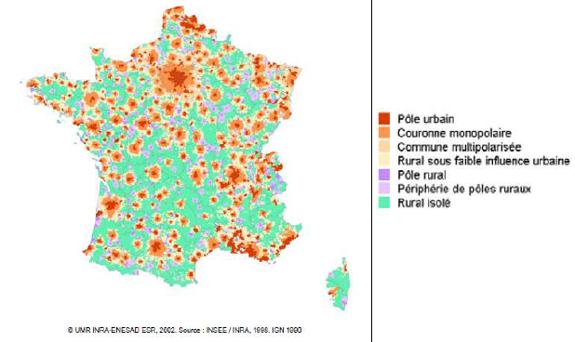

Slide 10
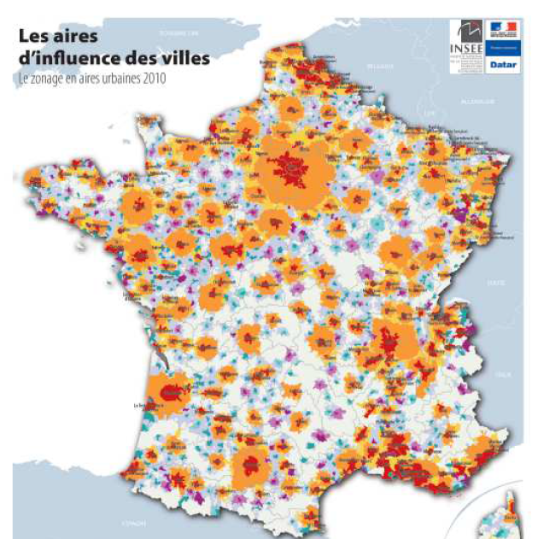
III. Since 2010, from “the all urban” to renewal of rural: where is suburban/exurban?
“”The death of rural areas” (GF Dumont, 2010)
According to jobs providing by cities (central city and first suburb crown.
10.000, 5.000 and 1.500
Commuting with at least 40% of active people
Areas without urban influence are colored in pale grey
An urban approach

Slide 11
III. Since 2010, from “the all urban” to renewal of rural: where is suburban/exurban?
European Union and the issue of density
Building a comparative statistic
Eurostat issue: building comparative data
The new dimension of “density”
Several levels of density, from weak to high densities
A complex hierarchy of density
With urban units of at least 50,000 inhabitants
Integration of suburbs within urban units
Consequences (Bouba-Olga 2021)
Rural is come back, included into “low” and “very low” densities
Most part of suburbs are included into rural areas (map next slide)
Other are part of urban crown with higher densities

Slide 12
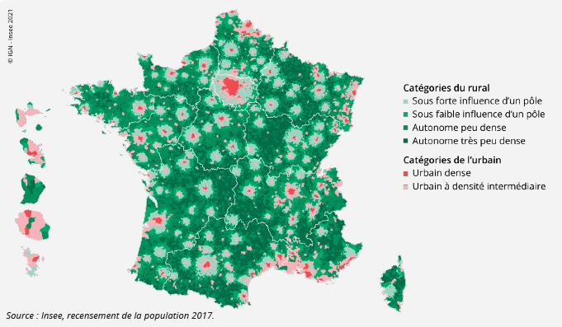
Suburban and exurban areas

Slide 13
Conclusion
Statistical approach is not the only one to definite suburban evolution
Otherwise, geographers often refer to data, today and yesterday, to understand and classify areas.
Of course, data building is not objective, representations are important into this construction
Finally, geographers are and were shared to suburban/exurban evolution
But beyond data and fear for the definition of rural, other approaches exist, more social, and geographical, than statistical
In France, statistically, until now, périurbain is always an in-between

Slide 14
Main References:
Aliaga Christel, Le zonage en aires urbaines, réflexions et avancées statistiques [The “urban areas” zoning, data progress and analyzese], INSEE Méthodes, n° 109, mars 2015, p. 11-40. https://www.insee.fr/fr/information/2571258, viewed February 4th, 2023.
Bouba-Olga Olivier, Qu’est-ce que le “rural”? Analyse des zonages de l’INSEE en vigueur depuis 2020 [ What is “rural” Analyzis of INSEE zoning since 2020], Géoconfluences, 2021, https://geoconfluences.ens-lyon.fr/actualites/eclairage/grille-densite-zonage-aires-urbaines-definition-rural, viewed January 15th, 2023.
Brétagnolle Anne, La naissance du périurbain comme catégorie statistique en France. une perspective internationale [The birth of suburban as a new type of statistic. An international viewpoint], L’Espace géographique, 44, 2015-1, p. 18-37.
D’Alessandro Cristina, Levy David, Régnier David, Une nouvelle définition du rural pour mieux rendre compte des réalités des territoires et de leurs transformations [A new definition of rural to better understand territories and their transformations], INSEE Références, 2021, p. 61-71.
Dumont Gérard-François, Un meurtre géographique: la France rurale [A geographical murder: The rural France], Population et Avenir, 707, 2010-2, p.1-3.
Pistre Pierre, Richard Frédéric, Seulement 5 ou 15% de ruraux en France? Les malentendus du zonage en aires urbaines [Only 5 or 15% rural inhabitants in France? The misunderstandings of “urban areas” zoning], Géoconfluences, viewed January 13th, 2023. https://geoconfluences.ens-lyon.fr/informations-scientifiques/dossiers-regionaux/france-espaces-ruraux-periurbains/articles-scientifiques/definition-espace-rural-France, viewed on February 14th, 2023.
Stébé Jean-Marc, L’INSEE et ses zonages: au-delà de l’opposition urbain-rural [The INSEE and its zonings: beyond urban-rural opposition], Constructif, 60, 2021-3, p. 22-26. DOI 10.3917/const.060.0022

